Slide 1

Team Galactic Chalupa
David, Eric, Fred, Stephan

Slide 2
Hypothesis
Local cultural events drive traffic to neighbourhood shops
Les événements culturels locaux amènent des clients dans les commerces du secteur.

Slide 3
Datasets
Yelp
La Vitrine
review
date
business
name
location
reviews
event
dates
location
review
date
...

Slide 4


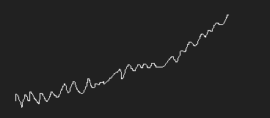
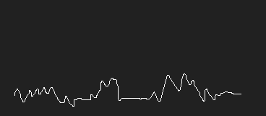
Normalization
All reviews
All reviews (normalized)
All reviewsfdssdf
Schwartz’s
Schwartz’s (normalized)

Slide 5
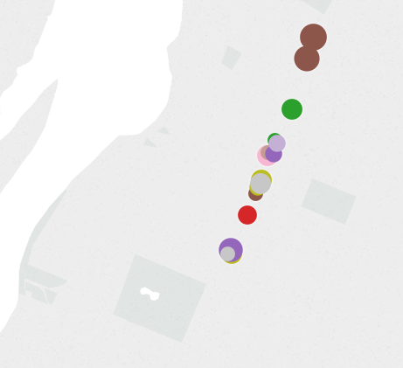
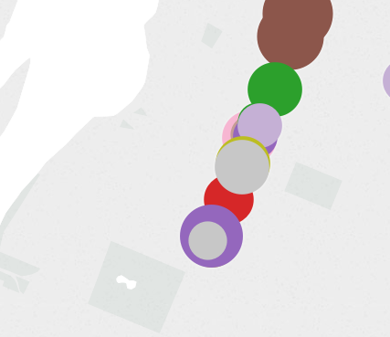
Festiblues Ahuntsic
Before (July)
During (August)
After (September)
17 reviews
28 reviews
13 reviews

Slide 6
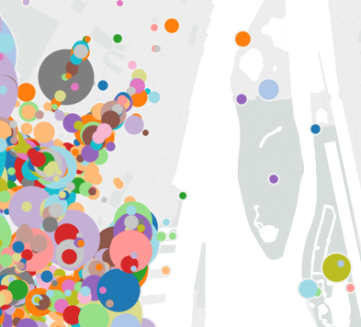
Osheaga
Before (June)
During (July)
After (August)
173 reviews
281 reviews
132 reviews

Slide 7
Conclusion
What we learned:
Transforming data is time consuming! Even more so at a scale!
What we could have done:
- Validate assumptions with data from other sources (e.g. Facebook, Foursquare check-ins?)
What would have helped:
Having access to historical data from LaVitrine;
Having access to Yelp Check In data to compare vs. Reviews

